Slide 1
Employee Data Analysis using Excel
STUDENT NAME: MAGESHWARI. M
REGISTER NO: 312205913
DEPARTMENT: BCOM (GENERAL)
COLLEGE: VIDHYASAGAR WOMEN'S COLLEGE
1

Slide 2
PROJECT TITLE
Employee Data Set Analysis using Excel
2

Slide 3


3/21/2024 Annual Review
AGENDA
1.Problem Statement 2.Project Overview 3.End Users
4.Our Solution and Proposition 5.Dataset Description 6.Modelling Approach 7.Results and Discussion 8.Conclusion
3

Slide 4

PROBLEM STATEMENT
To analyze the employee data set to identify key trends, patterns, and areas for improvement within the organization. This will help in making data-driven decisions related to workforce management, employee performance, and overall organizational efficiency.
4

Slide 5

PROJECT OVERVIEW
This overview provides a structured approach to the project, detailing the objectives, methodology, and expected outcomes. Adjust the details based on your specific project requirements and available data.
5

Slide 6


WHO ARE THE END USERS?
HR Managers: To develop targeted employee engagement initiatives and improve HR policies.
Senior Management: To guide strategic decisions and evaluate overall organizational performance.
Line Managers: To improve team performance and manage day- to-day operational challenges.
6

Slide 7

OUR SOLUTION AND ITS VALUE PROPOSITION
1.Conditional Formatting:
To highlights the missing value of the data.
2.Filter:
To remove the missing value of the data.
3.Formula:
To find the employees performance level in the data.
4.Pivot Table:
To summary the employees data.
5.Graph:
To visualization of the employees data in the organisation.
7

Slide 8
Dataset Description
Name: Full name of the employee
Department: The department where the employee works
Age: The age of the employee.
Gender: The gender of the employee (e.g., Male, Female, Non- Binary)
Salary/Compensation: The employee’s base salary or total compensation package.
Empolyee Status: Employment status (e.g., Full-Time, Part-Time, Contract)

Slide 9

THE "WOW" IN OUR SOLUTION
Performance level:=SUMIF(D2:D100, "Training", E2:E100)
3/21/2024 Annual Review
9

Slide 10
MODELLING
Identify what you want to achieve with your modeling. Common objectives might include:
Predicting employee turnover.
Analyzing the impact of training on performance.
Assessing factors influencing compensation.
10

Slide 11
Data Cleaning:
1.Conditional Formatting:
To highlights the missing value of the data.
2.Filter:
To remove the missing value of the data.
Performance level:
=SUMIF(D2:D100, "Training", E2:E100)
Summary: 1.Pivot Table:
To summary the employees data.
2.Graph:
To visualization of the employees data in the organisation.

Slide 12
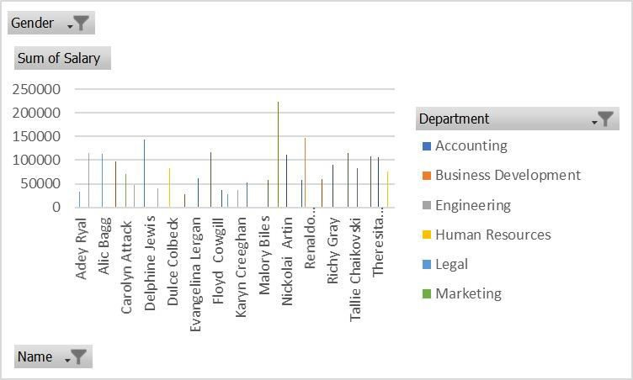
RESULTS

Slide 13
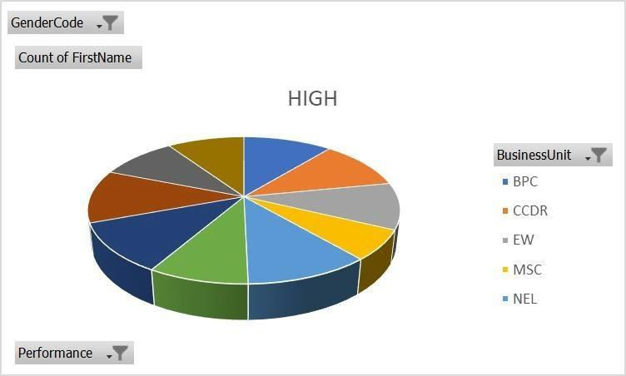
1

Slide 14
Conclusion
After performing a comprehensive analysis of the employee data set using Excel, several key insights
and conclusions can be drawn. This section summarizes
the findings, implications, and recommendations based on the modeling and analysis conducted.

